Slide 1
TT Oceaneous Outreach - 11/8

Slide 2


Educational

Slide 3

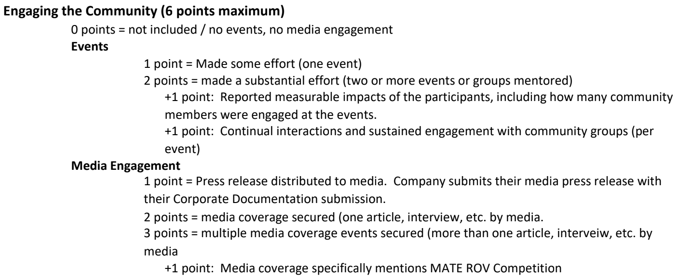
Community

Slide 4


Environment

Slide 5


Knowledge

